Slide 1
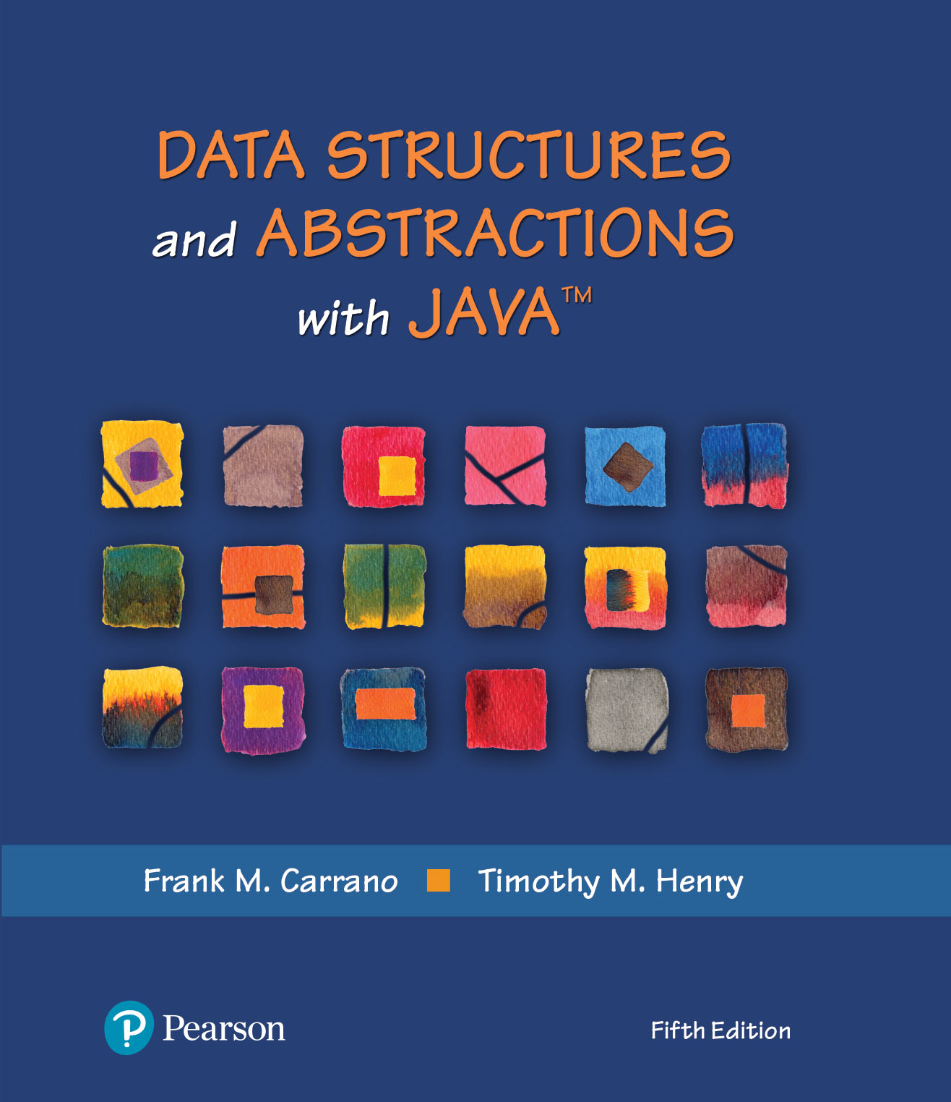
Data Structures and Abstractions with Java™
5th Edition
Module 13 - Hashing
Including:
Chapter 22 - Introducing Hashing
Chapter 23 – Hashing as Dictionary implementation

Slide 2
Hashing
A technique that determines an index into a table using only an entry’s search key
Hash function
Takes a search key and produces the integer index of an element in the hash table
Search key is mapped, or hashed, to the index

Slide 3
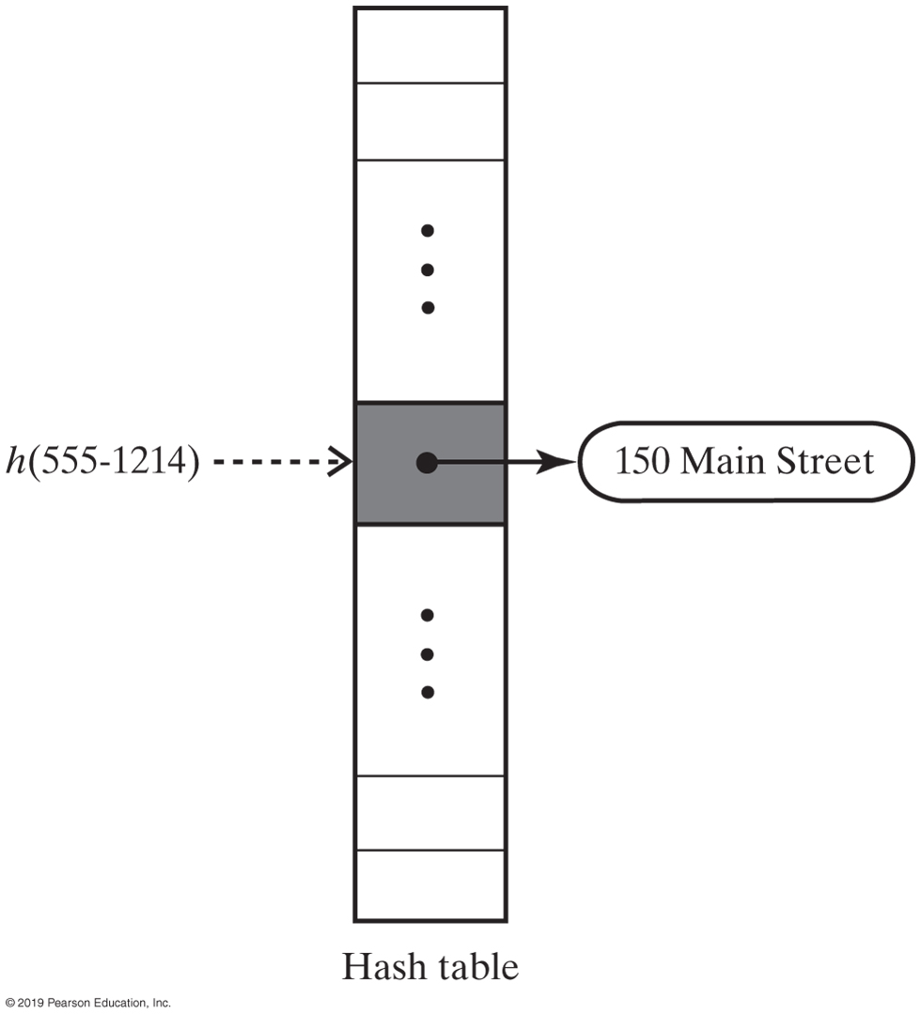
Hash Table
FIGURE 22-1 A hash function indexes its hash table

Slide 4
Ideal Hashing
Algorithm add(key, value)
index = h(key)
hashTable[index] = value
Algorithm getValue(key)
index = h(key)
return hashTable[index]
Simple algorithms for the dictionary operations that add and retrieve

Slide 5
Typical Hashing
Typical hash functions perform two steps:
Convert search key to an integer
Called the hash code.
Compress hash code into the range of indices for hash table.
Algorithm getHashIndex(phoneNumber)
// Returns an index to an array of tableSize elements.
i = last four digits of phoneNumber
return i % tableSize

Slide 6
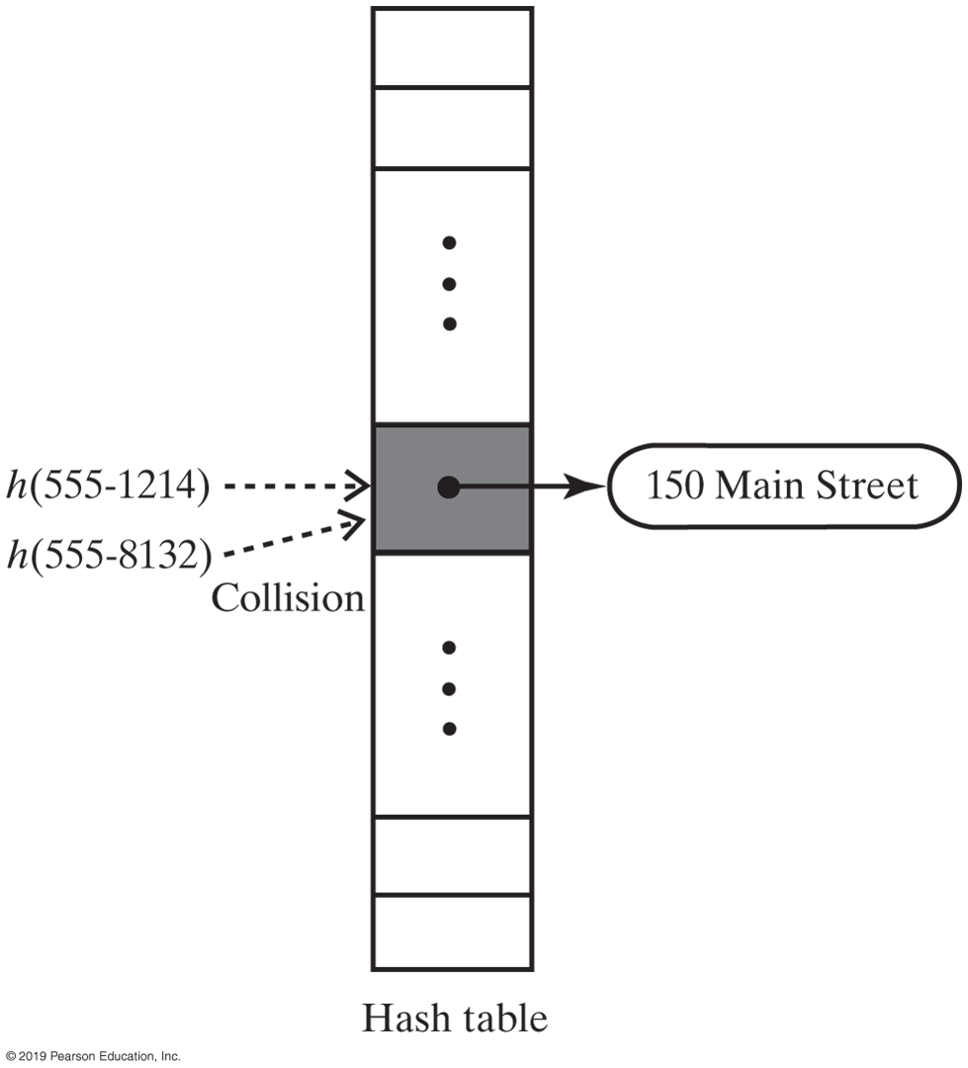
Typical Hashing
Most hash functions are not perfect,
Can allow more than one search key to map into a single index
Causes a collision in the hash table
Consider tableSize = 101
getHashIndex(555-1214) = 52
getHashIndex(555-8132) = 52 also!!!
FIGURE 22-2 A collision caused by the hash function h

Slide 7
Hash Functions
A good hash function should
Minimize collisions
Be fast to compute
To reduce the chance of a collision
Choose a hash function that distributes entries uniformly throughout hash table.

Slide 8
Computing Hash Codes
Java’s base class Object has a method hashCode that returns an integer hash code
A class should define its own version of hashCode
A hash code for a string
Using a character’s Unicode integer is common
Better approach:
Multiply Unicode value of each character by factor based on character’s position,
Then sum values

Slide 9
Sample Strings and their Hash Codes
String | Hash Code
"Adam" | 2035631
"Eve" | 700068
"Harry" | 69496448
"Jim" | 74478
"Joe" | 74656
"Juliet" | -2065036585
"Katherine" | 2079199209
"Sue" | 83491

Slide 10
Computing Hash Codes
Hash code for a string example:
Java code to do this:
u0g^{n-1} + u1g^{n-2} + … + u^{n-2}g + un-1
int hash = 0;
int n = s.length();
for (int i = 0; i < n; i++)
hash = g * hash + s.charAt(i);

Slide 11
Hash Code for a Primitive type
If data type is int,
Use the key itself
For byte, short, char:
Cast as int
Other primitive types
Manipulate internal binary representations

Slide 12
Compressing a Hash Code
Common way to scale an integer
Use Java mod operator %: code % n
Best to use an odd number for n
Prime numbers often give good distribution of hash values

Slide 13
Compressing a Hash Code
private int getHashIndex(K key)
{
int hashIndex = key.hashCode() % hashTable.length;
if (hashIndex < 0)
hashIndex = hashIndex + hashTable.length;
return hashIndex;
} // end getHashIndex
Hash function for the ADT dictionary

Slide 14
Resolving Collisions
Collision:
Hash function maps search key into a location in hash table already in use
Two choices:
Use another location in the hash table
Change the structure of the hash table so that each array location can represent more than one value

Slide 15
Resolving Collisions
Linear probing
Resolves a collision during hashing by examining consecutive locations in hash table
Beginning at original hash index
Find the next available one
Table locations checked make up probe sequence
If probe sequence reaches end of table, go to beginning of table (circular hash table)

Slide 16
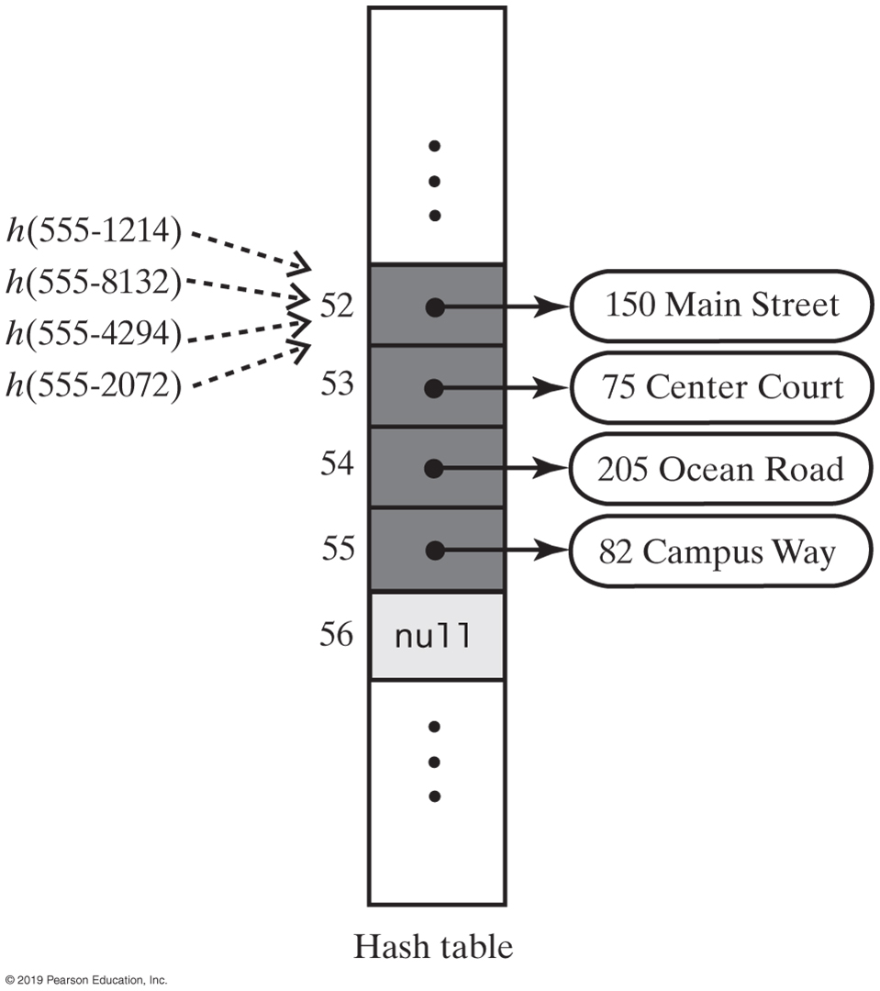
Linear Probing
FIGURE 22-3 The effect of linear probing after adding four entries whose search keys hash to the same index

Slide 17
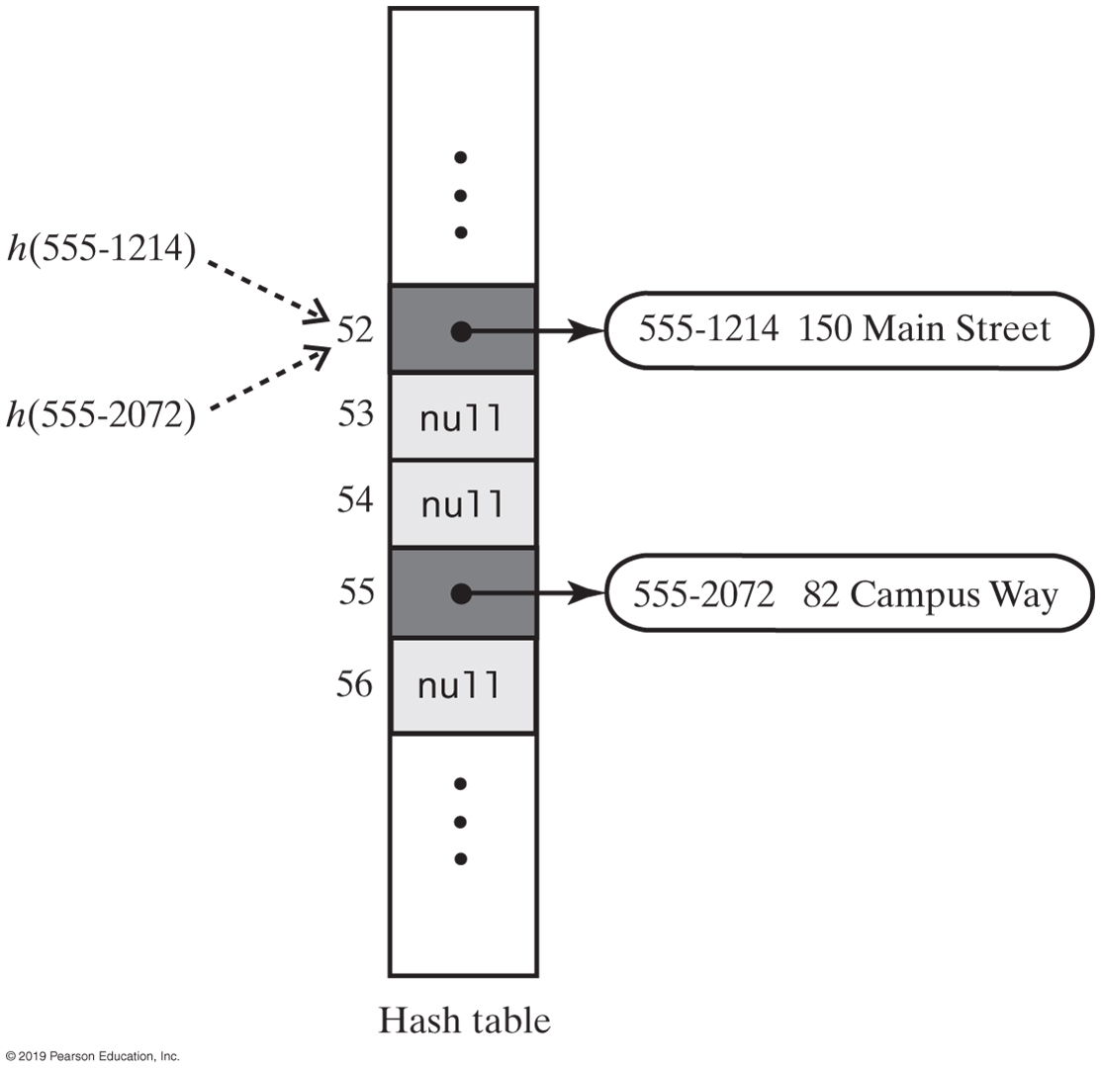
Linear Probing
FIGURE 22-5 A hash table if remove used null to remove entries

Slide 18
Resolving Collisions
Need to distinguish among three kinds of locations in the hash table
Occupied
location references an entry in the dictionary
Empty
location contains null and always has
Available
location’s entry was removed from the dictionary

Slide 19
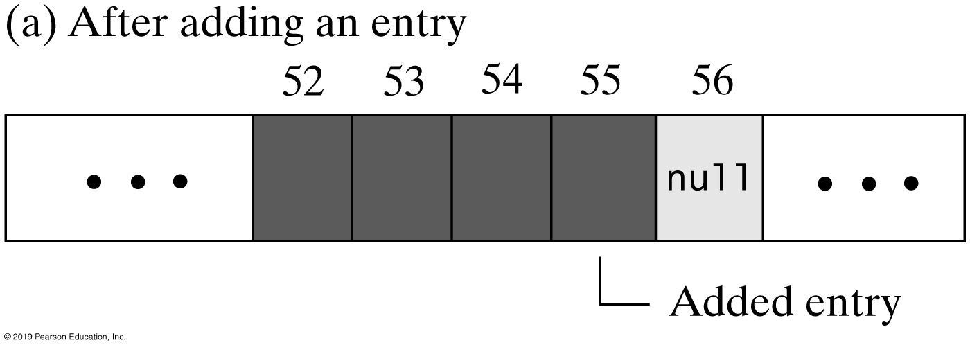
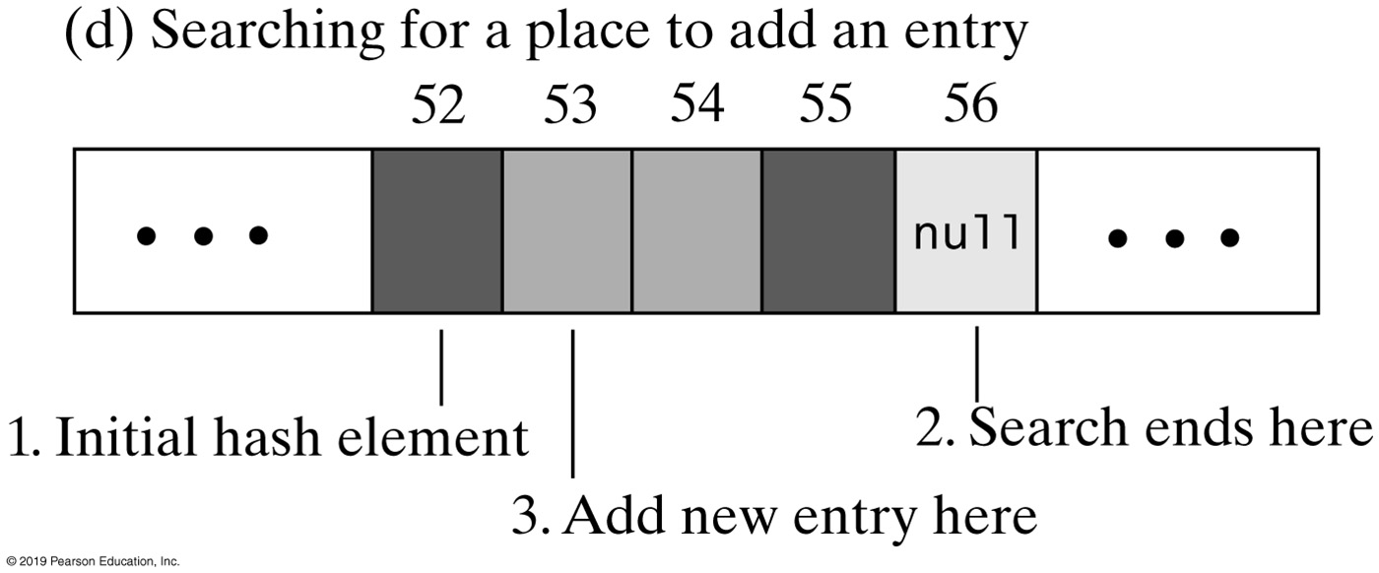
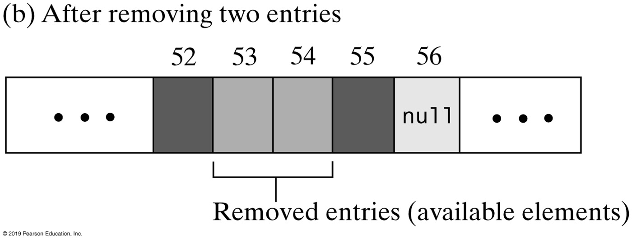
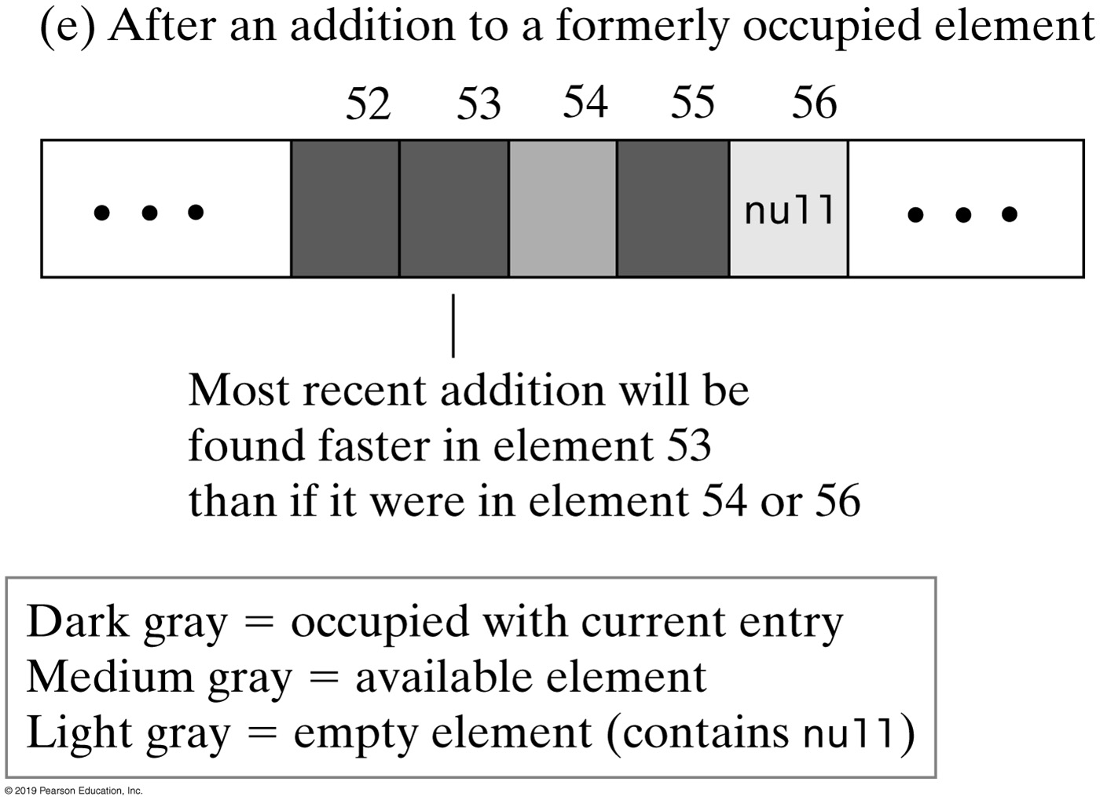
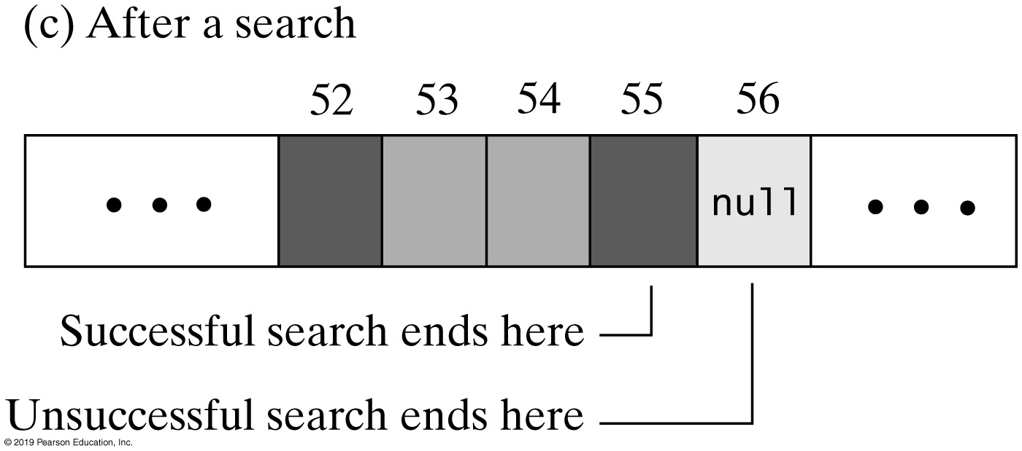
Linear Probing
FIGURE 22-6 The linear probe sequence in various situations

Slide 20
Linear Probing - Probe Algorithm
Algorithm probe(index, key)
// Searches the probe sequence that begins at index. Returns the index of either the element
// containing key or an available element in the hash table.
while (key is not found and hashTable[index] is not null)
{
if (hashTable[index] references an entry in the dictionary)
{
if (the entry in hashTable[index] contains key)
Exit loop
else
index = next probe index
}
else // hashTable[index] is available
{
if (this is the first available element encountered)
availableStateIndex = index
index = next probe index
}
}
if (key is found or an available element was not encountered)
return index
else
return availableStateIndex // Index of first entry removed

Slide 21
Linear Probe Algorithm
// Precondition: checkIntegrity has been called.
private int linearProbe(int index, K key)
{
boolean found = false;
int availableStateIndex = −1; // Index of first element in available state
while ( !found && (hashTable[index] != null) )
{
if (hashTable[index] != AVAILABLE)
{
if (key.equals(hashTable[index].getKey()))
found = true; // Key found
else // Follow probe sequence
index = (index + 1) % hashTable.length; // Linear probing
}
else // Element in available state; skip it, but mark the first one encountered
{
// Save index of first element in available state
if (availableStateIndex == −1) availableStateIndex = index;
index = (index + 1) % hashTable.length; // Linear probing
} // end if
} // end while
// Assertion: Either key or null is found at hashTable[index]
if (found || (availableStateIndex == −1) )
return index; // Index of either key or null
else
return availableStateIndex; // Index of an available element
} // end linearProbe

Slide 22
Clustering
Collisions resolved with linear probing cause groups of consecutive locations in hash table to be occupied
Each group is called a cluster
Bigger clusters mean longer search times following collision

Slide 23
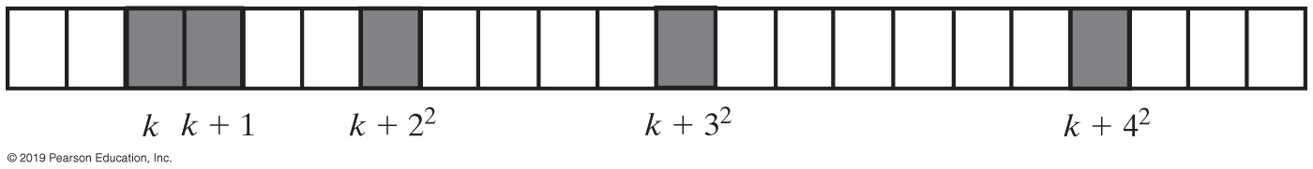
Open Addressing with Quadratic Probing
Linear probing looks at consecutive locations beginning at index k
Quadratic probing:
Considers the locations at indices k + j²
Uses the indices k, k + 1, k + 4, k + 9, …
FIGURE 22-7 A probe sequence of length five using quadratic probing

Slide 24
Open Addressing with Double Hashing
Linear probing and quadratic probing add increments to k to define a probe sequence
Both are independent of the search key
Double hashing uses a second hash function to compute these increments
This is a key-dependent method.

Slide 25
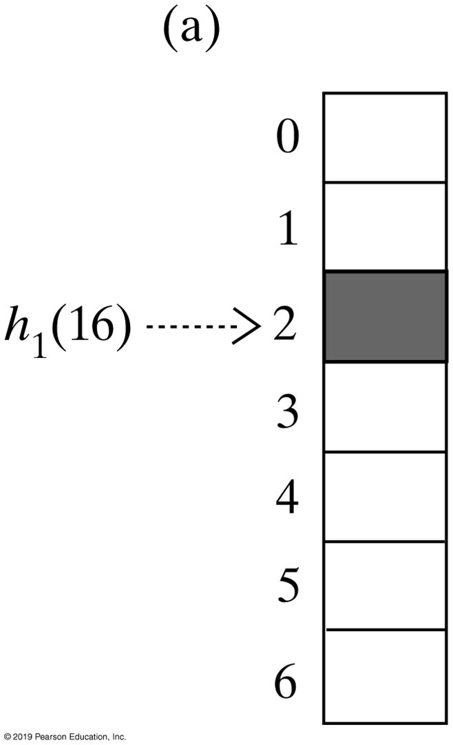
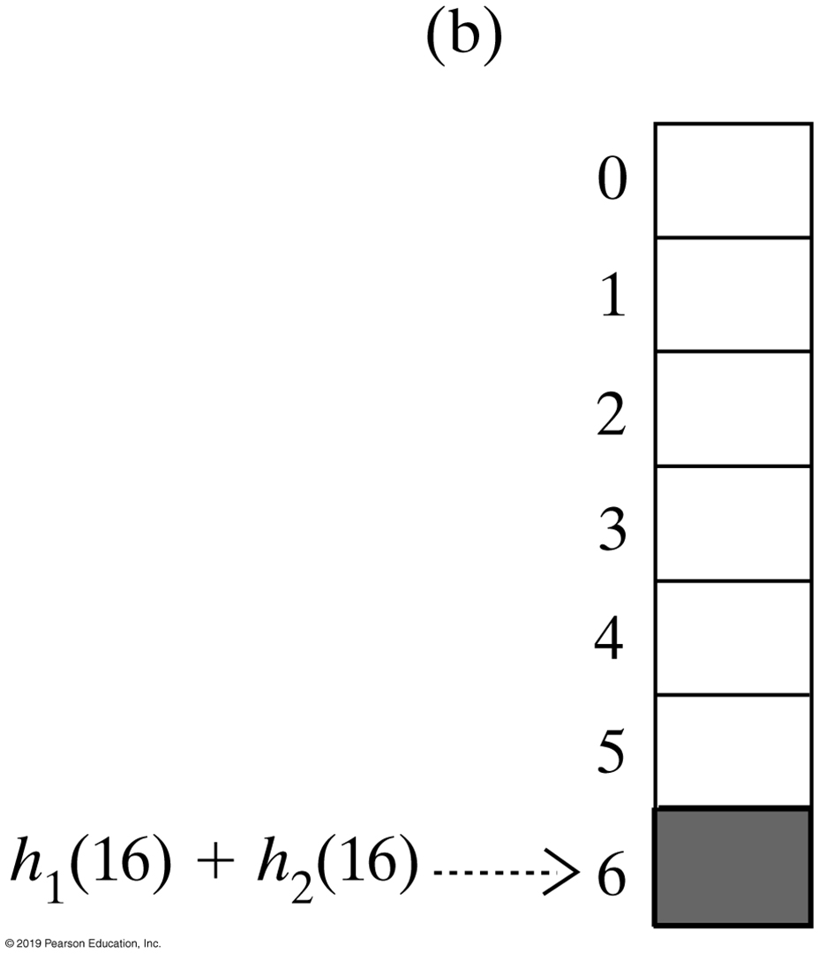
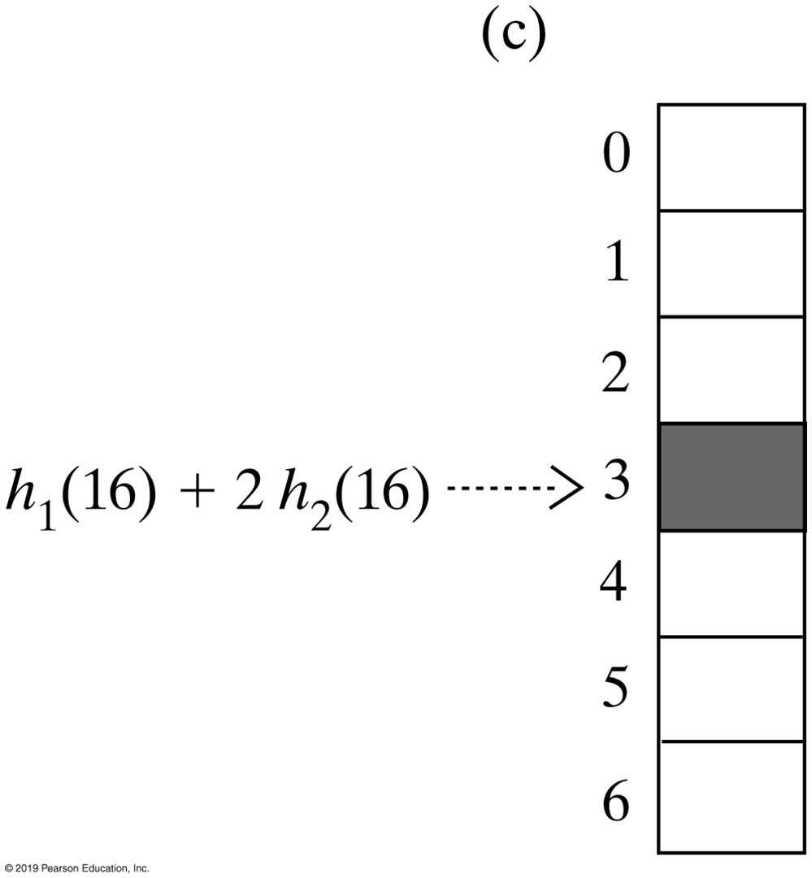
Open Addressing with Double Hashing
FIGURE 22-8 The first three elements in a probe sequence generated by double hashing for the search key 16

Slide 26
Potential Problem with Open Addressing
Recall each location is either occupied, empty, or available
Frequent additions and removals can result in no locations that are null
Thus searching a probe sequence will not work
Consider separate chaining as a solution

Slide 27
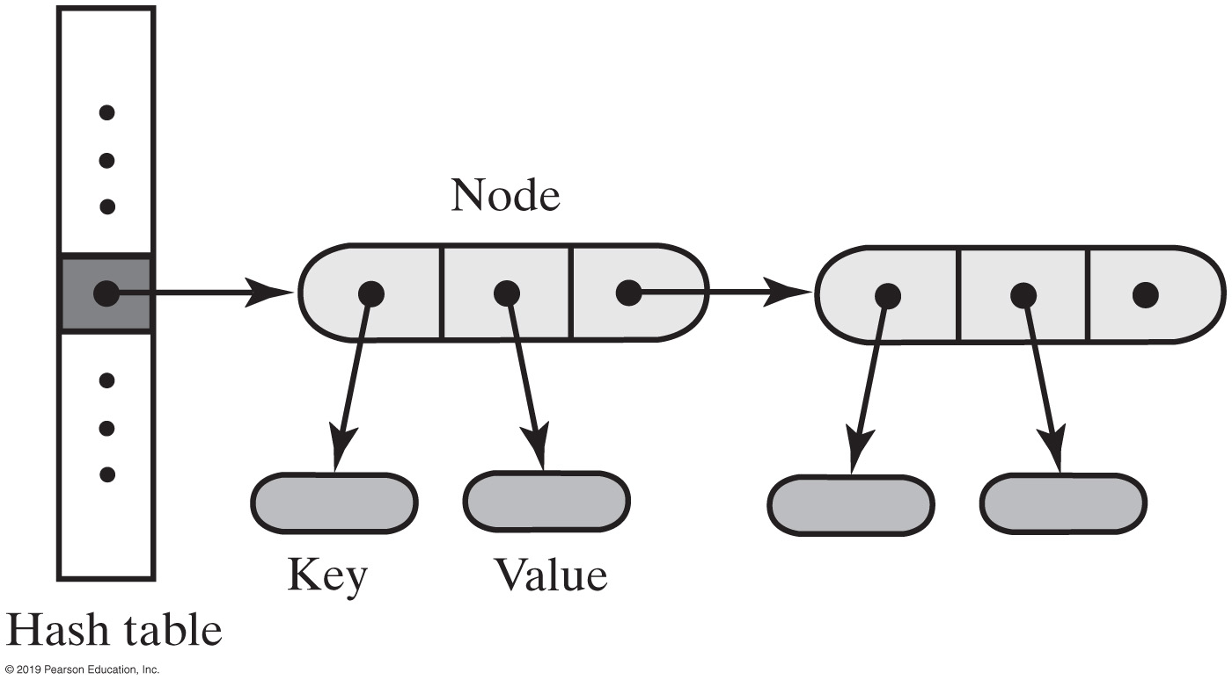
Separate Chaining
Alter the structure of the hash table
Each location can represent more than one value.
Such a location is called a bucket
Decide how to represent a bucket
list, sorted list
array
linked nodes
vector
FIGURE 22-9 A hash table for use with separate chaining; each bucket is a chain of linked nodes

Slide 28
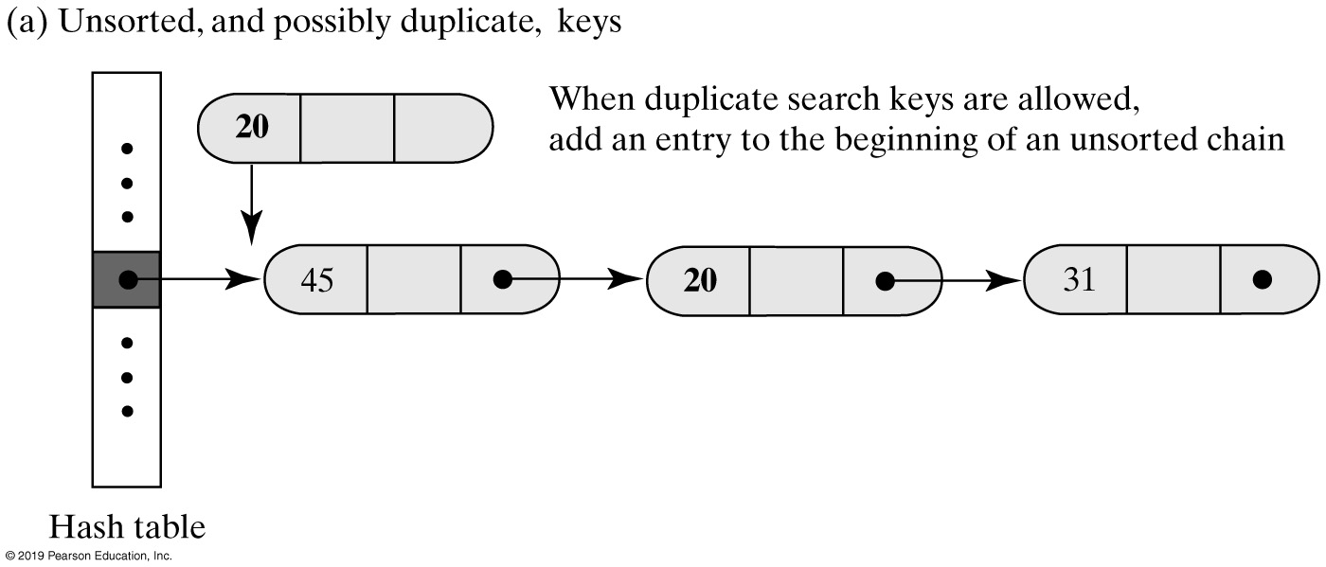
Separate Chaining
FIGURE 22-10a Inserting a new entry into a linked bucket according to the nature of the integer search keys

Slide 29
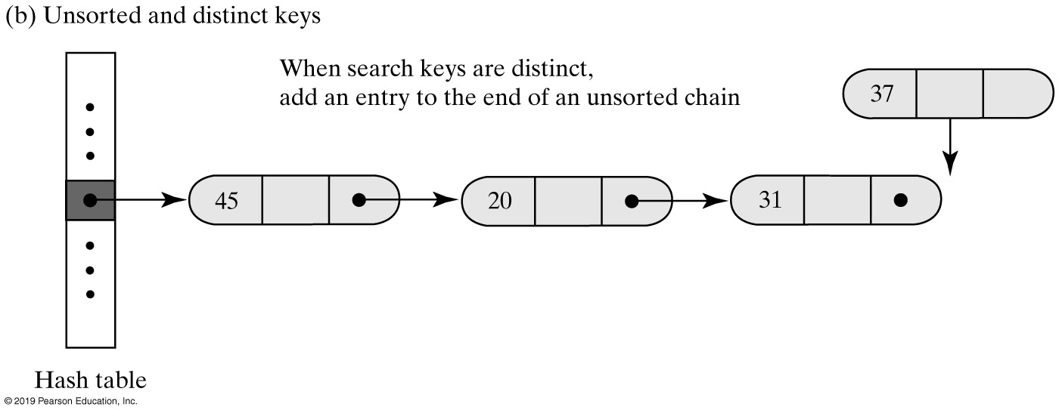
Separate Chaining
FIGURE 22-10b Inserting a new entry into a linked bucket according to the nature of the integer search keys

Slide 30
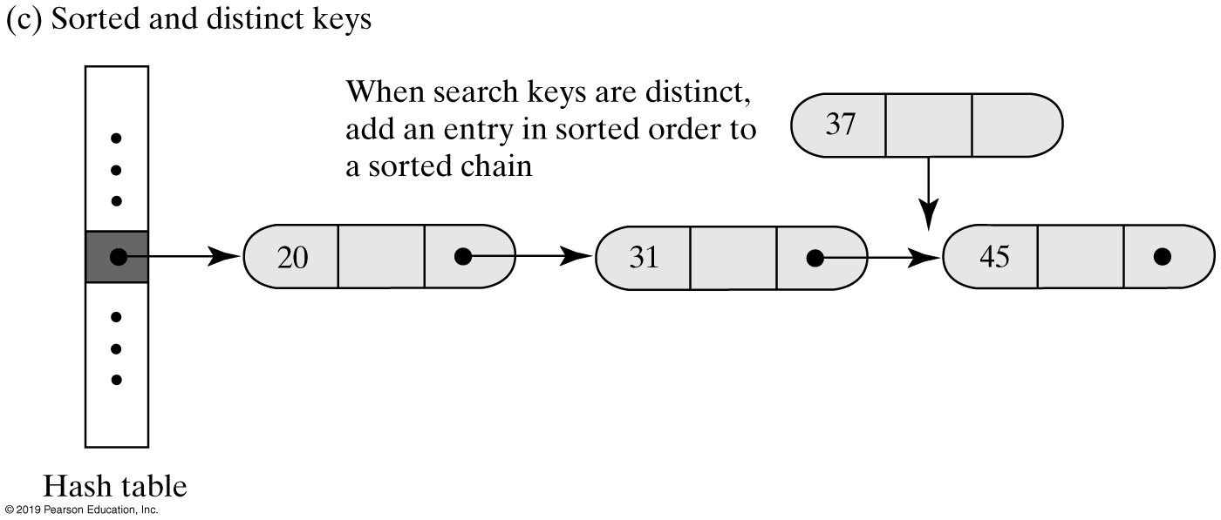
Separate Chaining
FIGURE 22-10c Inserting a new entry into a linked bucket according to the nature of the integer search keys

Slide 31
Separate Chaining
Algorithm add(key, value)
index = getHashIndex(key)
if (hashTable[index] == null)
{
hashTable[index] = new Node(key, value)
numberOfEntries++
return null
}
else
{
Search the chain that begins at hashTable[index] for a node that contains key
if (key is found)
{ // Assume currentNode references the node that contains
key oldValue = currentNode.getValue()
currentNode.setValue(value)
return oldValue
}
else // Add new node to end of chain
{ // Assume nodeBefore references the last node
newNode = new Node(key, value)
nodeBefore.setNextNode(newNode) numberOfEntries++
return null
}
}
Algorithm for the dictionary’s add method.

Slide 32
Separate Chaining
Algorithm remove(key)
index = getHashIndex(key)
Search the chain that begins at hashTable[index] for a node that contains key
if (key is found)
{
Remove the node that contains key from the chain
numberOfEntries−−
return value in removed node
}
else
return null
Algorithm for the dictionary’s remove method.

Slide 33
Separate Chaining
Algorithm getValue(key)
index = getHashIndex(key)
Search the chain that begins at hashTable[index] for a node that contains key
if (key is found)
return value in found node
else
return null
Algorithm for the dictionary’s getValue method.

Slide 34
Efficiency of Hashing
Observations about the time efficiency of these operations
Successful retrieval/removal has same efficiency as successful search
Unsuccessful retrieval/removal has same efficiency as unsuccessful search
Successful addition has same efficiency as unsuccessful search
Unsuccessful addition has same efficiency as successful search

Slide 35
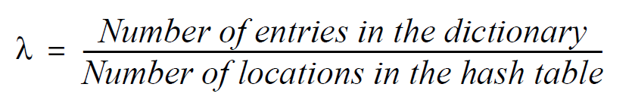
Load Factor
Definition of load factor:
Never negative
For open addressing, 1 ≥ λ
For separate chaining, λ has no maximum value
Restricting size of λ improves performance

Slide 36
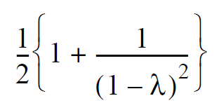
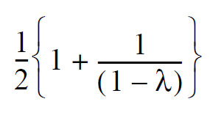
Cost of Open Addressing
Average number of searches for linear probing
For unsuccessful search:
For successful search:

Slide 37
Cost of Open Addressing
𝝀 | Unsuccessful Search | Successful Search
0.1 | 1.1 | 1.1
0.3 | 1.5 | 1.2
0.5 | 2.5 | 1.5
0.7 | 6.1 | 2.2
0.9 | 50.5 | 5.5
FIGURE 23-1 The average number of comparisons required by a search of the hash table for given values of the load factor λ when using linear probing

Slide 38
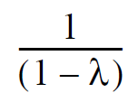
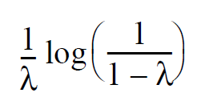
Quadratic Probing and Double Hashing
Average number of comparisons needed
For unsuccessful search:
For successful search:

Slide 39
Quadratic Probing and Double Hashing
𝝀 | Unsuccessful Search | Successful Search
0.1 | 1.1 | 1.1
0.3 | 1.5 | 1.2
0.5 | 2.0 | 1.4
0.7 | 3.3 | 1.7
0.9 | 10.0 | 2.6
FIGURE 23-2 The average number of comparisons required by a search of the hash table for given values of the load factor λ when using either quadratic probing or double hashing

Slide 40
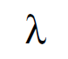
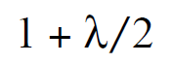
Cost of Separate Chaining
Average number of comparisons during a search when separate chaining is used
For unsuccessful search:
For successful search:
To maintain reasonable efficiency, you should keep λ < 1.

Slide 41
Cost of Separate Chaining
𝝀 | Unsuccessful Search | Successful Search
0.1 | 0.1 | 1.1
0.3 | 0.3 | 1.2
0.5 | 0.5 | 1.3
0.7 | 0.7 | 1.4
0.9 | 0.9 | 1.5
1.1 | 1.1 | 1.6
1.3 | 1.3 | 1.7
1.5 | 1.5 | 1.8
1.7 | 1.7 | 1.9
1.9 | 1.9 | 2.0
2.0 | 2.0 | 2.0
FIGURE 23-3 The average number of comparisons required by a search of the hash table for given values of the load factor λ when using separate chaining

Slide 42
Maintaining the Performance of Hashing
To maintain efficiency, restrict the size of λ as follows:
λ < 0.5 for open addressing
λ < 1.0 for separate chaining
Should the load factor exceed these bounds
Increase the size of the hash table

Slide 43
Rehashing
When the load factor λ becomes too large must resize the hash table
Compute the table’s new size
Double its present size
Increase the result to the next prime number
Use method add to add the current entries in dictionary to new hash table

Slide 44
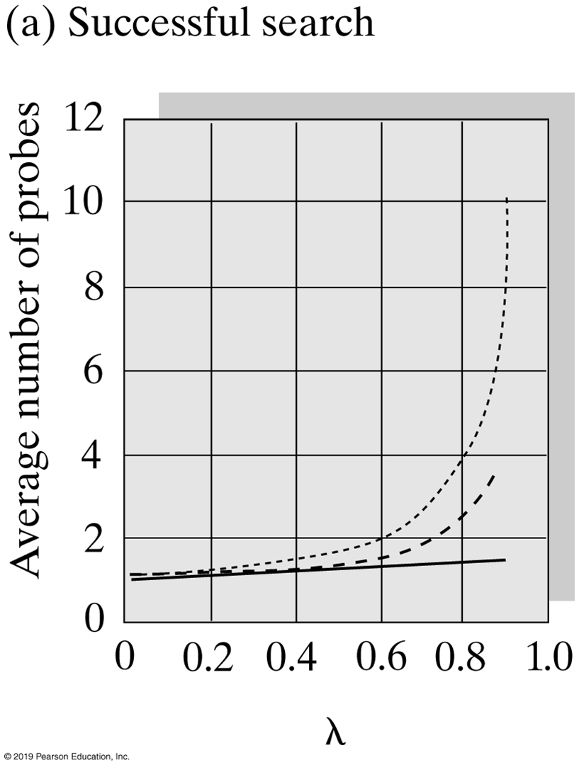
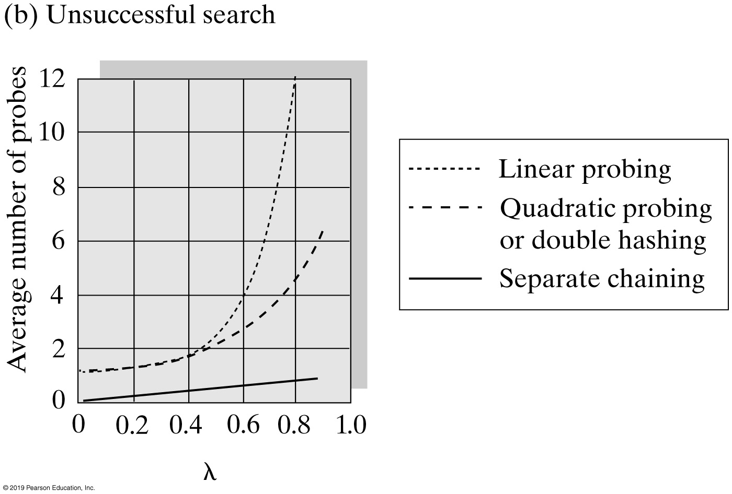
Comparing Schemes for Collision Resolution
FIGURE 23-4 The average number of comparisons required by a search of the hash table versus the load factor λ for four collision resolution techniques

Slide 45
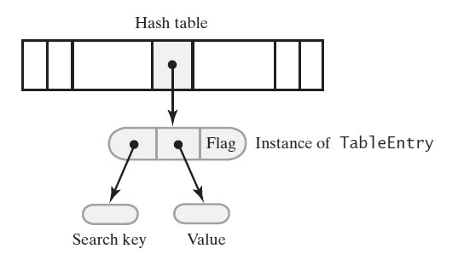
Dictionary Implementation That Uses Hashing
FIGURE 23-5 A hash table and one of its entry objects

Slide 46
Dictionary Implementation That Uses Hashing
private static class TableEntry<S, T>
{
private S key;
private T value;
private States state; // Flags whether this entry is in the hash table
private enum States {CURRENT, REMOVED} // Possible values of state
private TableEntry(S searchKey, T dataValue)
{
key = searchKey;
value = dataValue;
state = States.CURRENT;
} // end constructor
// method implementations go here
} // end TableEntry
Private class TableEntry, make it internal to the dictionary class.

Slide 47
A Dictionary that Uses Hashing (Part 1)
public class HashedDictionary<K, V> implements DictionaryInterface<K, V>
{
// The dictionary:
private int numberOfEntries;
private static final int DEFAULT_CAPACITY = 5; // Must be prime
private static final int MAX_CAPACITY = 10000;
// The hash table:
private Entry<K, V>[] hashTable;
private int tableSize; // Must be prime
private static final int MAX_SIZE = 2 * MAX_CAPACITY;
private boolean integrityOK = false;
private static final double MAX_LOAD_FACTOR = 0.5; // Fraction of
// hash table that can be filled
protected final Entry<K, V> AVAILABLE = new Entry<>(null, null);
public HashedDictionary()
{
this(DEFAULT_CAPACITY); // Call next constructor
} // end default constructor
LISTING 23-1 An outline of the class HashedDictionary

Slide 48
A Dictionary that Uses Hashing (Part 2)
public HashedDictionary(int initialCapacity)
{
initialCapacity = checkCapacity(initialCapacity);
numberOfEntries = 0; // Dictionary is empty
// Set up hash table:
// Initial size of hash table is same as initialCapacity if it is prime;
// otherwise increase it until it is prime size
int tableSize = getNextPrime(initialCapacity);
checkSize(tableSize); // Check that size is not too large
// The cast is safe because the new array contains null entries
@SuppressWarnings("unchecked")
Entry<K, V>[] temp = (Entry<K, V>[])new Entry[tableSize];
hashTable = temp;
integrityOK = true;
} // end constructor
/* Implementations of methods in DictionaryInterface are here. . . .
Implementations of private methods are here. . . . */
protected final class Entry<S, T>
{
/* . . . */
} // end Entry
} // end HashedDictionary
LISTING 23-1 An outline of the class HashedDictionary

Slide 49
Required Methods
Algorithm getValue(key)
// Returns the value associated with the given search key, if it is in the dictionary.
// Otherwise, returns null.
if (key is found)
return value in found entry
else
return null
Algorithm for the retrieval method getValue

Slide 50
Required Methods
public V getValue(K key)
{
checkIntegrity();
V result = null;
int index = getHashIndex(key);
if ((hashTable[index] != null) && (hashTable[index] != AVAILABLE))
result = hashTable[index].getValue(); // Key found; get value
// Else key not found; return null
return result;
} // end getValue
Implementation of method getValue

Slide 51
Required Methods
Algorithm remove(key)
// Removes a specific entry from the dictionary, given its search key.
// Returns either the value that was associated with the search key or null if no such object
// exists.
removedValue = null
index = getHashIndex(key)
if (key is found) // hashTable[index] is not null and does not equal AVAILABLE
{
removedValue = hashTable[index].getValue()
hashTable[index] = AVAILABLE
numberOfEntries--
}
return removedValue
Pseudocode for method remove

Slide 52
Required Methods
Algorithm add(key, value)
// Adds a new key-value entry to the dictionary. If key is already in the dictionary,
// returns its corresponding value and replaces it in the dictionary with value.
if ((key == null) or (value == null))
Throw an exception
index = getHashIndex(key)
if (key is not found)
{ // Add entry to hash table
hashTable[index] = new Entry(key, value)
numberOfEntries++
oldValue = null
}
else // Search key is in table; replace and return entry’s value
{
oldValue = hashTable[index].getValue()
hashTable[index].setValue(value)
}
// Ensure that hash table is large enough for another addition
if (hash table is too full)
Enlarge hash table
return oldValue
Algorithm for adding a new entry

Slide 53
Required Methods
private void enlargeHashTable()
{
Entry<K, V>[] oldTable = hashTable;
int oldSize = hashTable.length;
int newSize = getNextPrime(oldSize + oldSize);
checkSize(newSize);
// The cast is safe because the new array contains null entries
@SuppressWarnings("unchecked")
Entry<K, V>[] temp = (Entry<K, V>[])new Entry[newSize];
hashTable = temp;
numberOfEntries = 0; // Reset number of dictionary entries, since
// it will be incremented by add during rehash
// Rehash dictionary entries from old array to the new and bigger array;
// skip elements that contain null or AVAILABLE
for (int index = 0; index < oldSize; index++)
{
if ( (oldTable[index] != null) && oldTable[index] != AVAILABLE )
add(oldTable[index].getKey(), oldTable[index].getValue());
} // end for
} // end enlargeHashTable
Private method enlargeHashTable

Slide 54
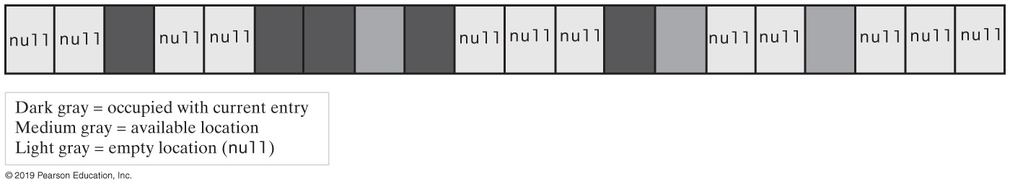
Hash Tables and Iterators
FIGURE 23-5 A hash table containing occupied elements, available elements, and null values

Slide 55
Hash Tables and Iterators (Part 1)
private class KeyIterator implements Iterator<K>
{
private int currentIndex; // Current position in hash table
private int numberLeft; // Number of entries left in iteration
private KeyIterator()
{
currentIndex = 0;
numberLeft = numberOfEntries;
} // end default constructor
public boolean hasNext()
{
return numberLeft > 0;
} // end hasNext
public void remove()
{
throw new UnsupportedOperationException();
} // end remove
Implementation of KeyIterator

Slide 56
Hash Tables and Iterators (Part 2)
public K next()
{
K result = null;
if (hasNext())
{
// Skip table locations that do not contain a current entry
while ( (hashTable[currentIndex] == null) ||
(hashTable[currentIndex] == AVAILABLE) )
{
currentIndex++;
} // end while
result = hashTable[currentIndex].getKey();
numberLeft--;
currentIndex++;
}
else
throw new NoSuchElementException();
return result;
} // end next
} // end KeyIterator
Implementation of KeyIterator

Slide 57
Java Class Library: The Class HashMap
Hash table is a collection of buckets
Each bucket contains several entries
Variety of constructors provided
Default maximum load factor of 0.75
When limit exceeded, size of table increased by rehashing
Possible to avoid rehashing by setting number of buckets initially larger

Slide 58
Java Class Library: The Class HashSet
Implements the interface java.util.Set
HashSet uses an instance of the class HashMap
Variety of constructors provided in class

Slide 59
Java Class Library: The Class HashTable
Hybrid dynamic hashed structure
Uses expandable linked lists to resolve collisions
Primary storage also expands when the loading factor exceeds a specified maximum
Unencapsulated generic structure
Key can be any type of object
Key class should overwrite the method equals and hashCode (the String and wrapper classes do this)
Hashtable’s operation methods invoke these methods

Slide 60
